Slide 1
Setting up Eclipse
Part 2

Slide 2
Overview
Git Exercise
Get Slides
Pull Requests
Downloads
Eclipse Swing plugin
Eclipse PHP plugin
Android Studio
How to Make a Web Browser

Slide 3
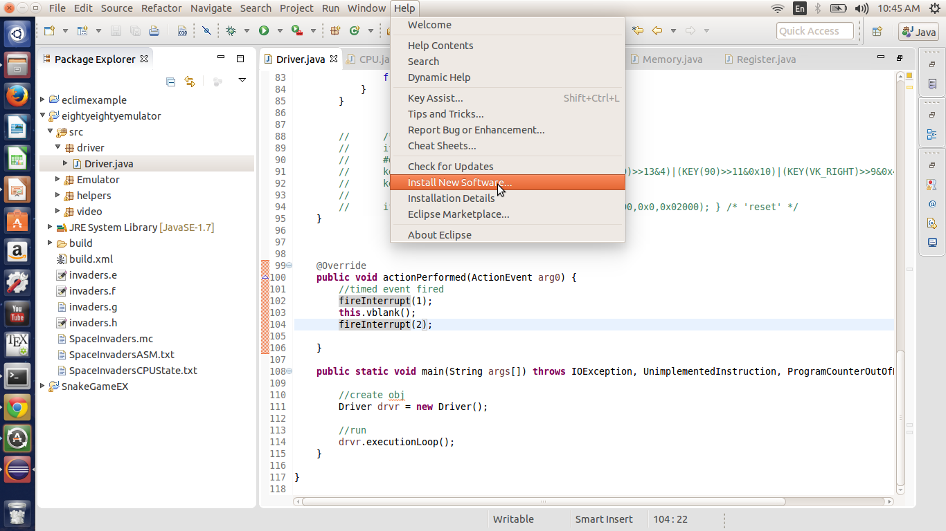
Eclipse Swing Plugin
Help
Install New Software

Slide 4
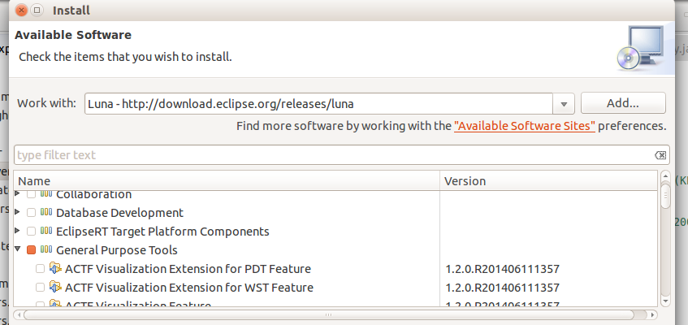
Eclipse Swing Plugin
1.
Work With
Select your Eclipse version
2.
Expand General Purpose tab
Select swing components (details in slide notes)
3. Hit next, accept all agreements, and restart eclipse
Notes:
Swing Designer 1.7.0.r44x201405021531
Swing Designer Documentation 1.7.0.r44x201405030444
SWT Designer 1.7.0.r44x201405021526
SWT Designer Core 1.7.0.r44x201405021519
SWT Designer Documentation 1.7.0.r44x201405030426
SWT Designer SWT_AWT Support 1.7.0.r44x201405021546
SWT Designer XWT Support (requires Eclipse WTP/WST) 1.7.0.r44x201405021548
TCF Terminal (Console) View 1.2.0.201406042322
WindowBuilder Core 1.7.0.r44x201405021445
WindowBuilder Core Documentation 1.7.0.r44x201405021506
WindowBuilder Core UI 1.7.0.r44x201405021455
WindowBuilder GroupLayout Support 1.7.0.r44x201405021517
WindowBuilder Java Core 1.7.0.r44x201405021448
WindowBuilder XML Core (requires Eclipse WTP/WST) 1.7.0.r44x201405021458

Slide 5
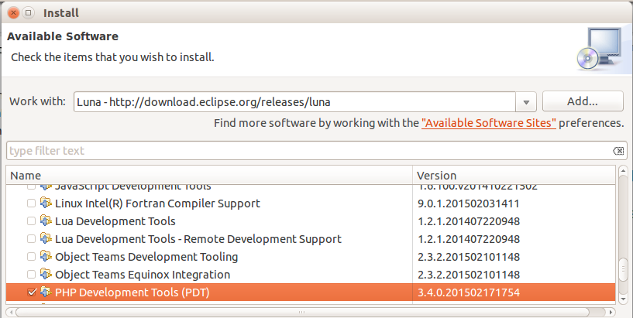
Eclipse PHP Plugin
1.
Work With
Select your Eclipse version
2.
Expand Programming Languages tab
Select PHP Development Tools (PDT)
3. Hit next, accept all agreements, and restart eclipse
Notes:
Swing Designer 1.7.0.r44x201405021531
Swing Designer Documentation 1.7.0.r44x201405030444
SWT Designer 1.7.0.r44x201405021526
SWT Designer Core 1.7.0.r44x201405021519
SWT Designer Documentation 1.7.0.r44x201405030426
SWT Designer SWT_AWT Support 1.7.0.r44x201405021546
SWT Designer XWT Support (requires Eclipse WTP/WST) 1.7.0.r44x201405021548
TCF Terminal (Console) View 1.2.0.201406042322
WindowBuilder Core 1.7.0.r44x201405021445
WindowBuilder Core Documentation 1.7.0.r44x201405021506
WindowBuilder Core UI 1.7.0.r44x201405021455
WindowBuilder GroupLayout Support 1.7.0.r44x201405021517
WindowBuilder Java Core 1.7.0.r44x201405021448
WindowBuilder XML Core (requires Eclipse WTP/WST) 1.7.0.r44x201405021458

Slide 6
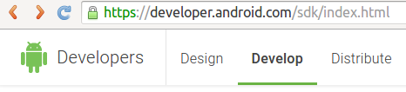
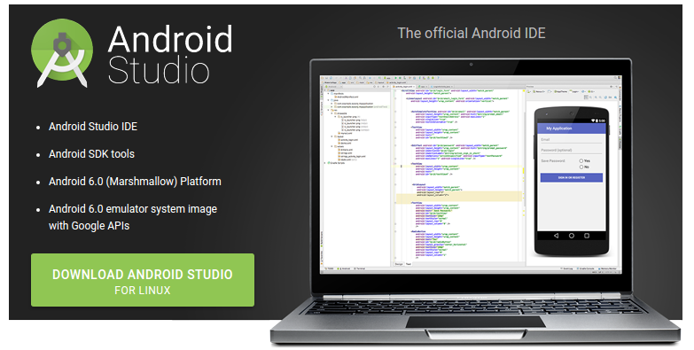
Android Studio
Follow Link
Download Tool
Notes:
Download Android Studio here:
https://developer.android.com/sdk/index.html

Slide 7
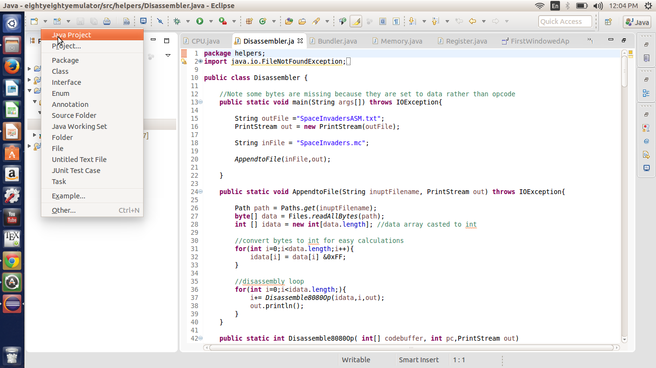
Creating Graphics Project
File → New → Java Project → Create name → Finish

Slide 8
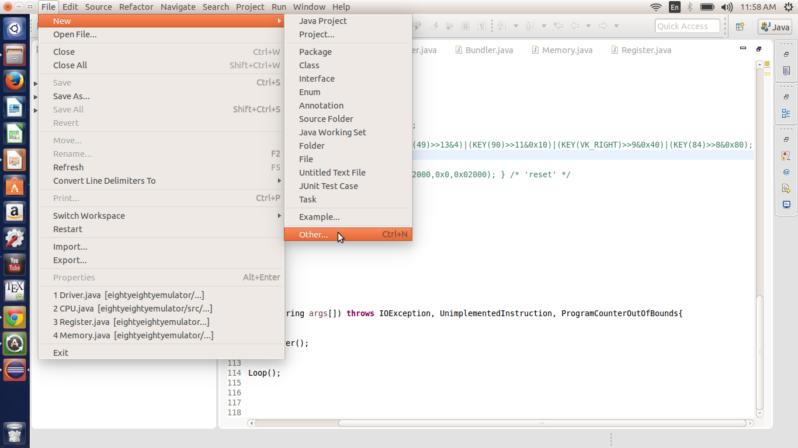
Creating Graphics Project
File → New → Other

Slide 9
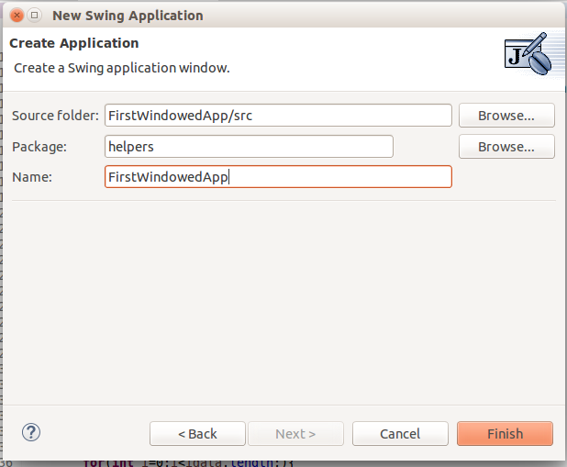
Creating Graphics Project

Slide 10
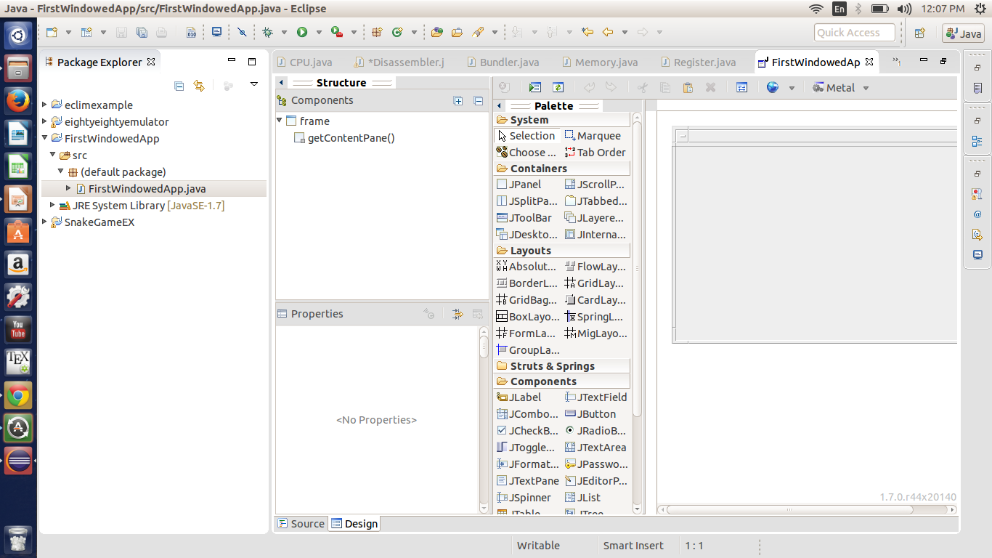
Creating Graphics Project
Click Design TAB

Slide 11
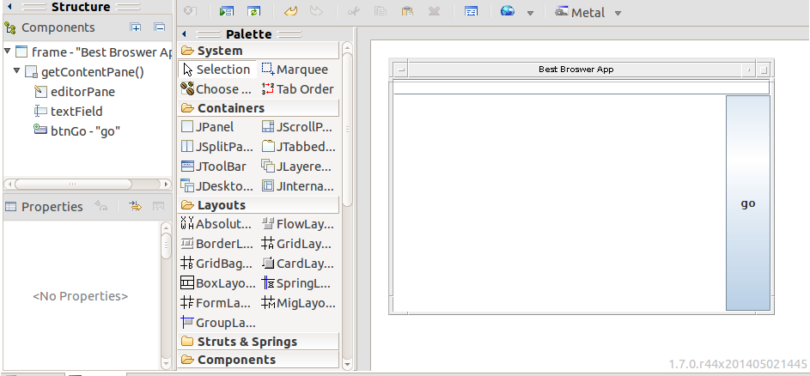
Creating Graphics Project
Grab and place Elements
Double-click to add Event listener

Slide 12
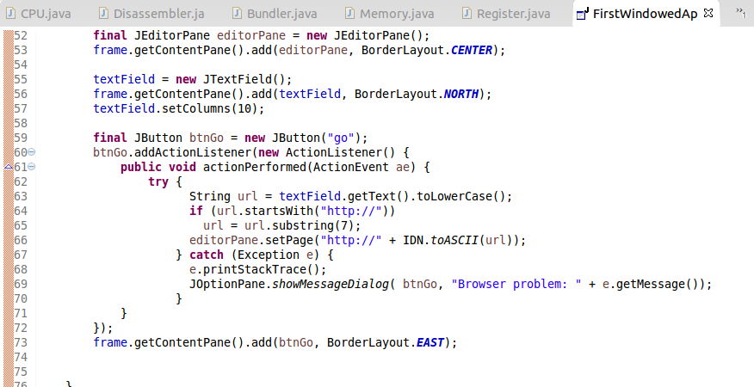
Creating Graphics Project
Add Functionality to Button

